Slide 1
Tech Tales & Triumphs: An Alumni Interaction

Slide 2
Session Overview

Slide 3
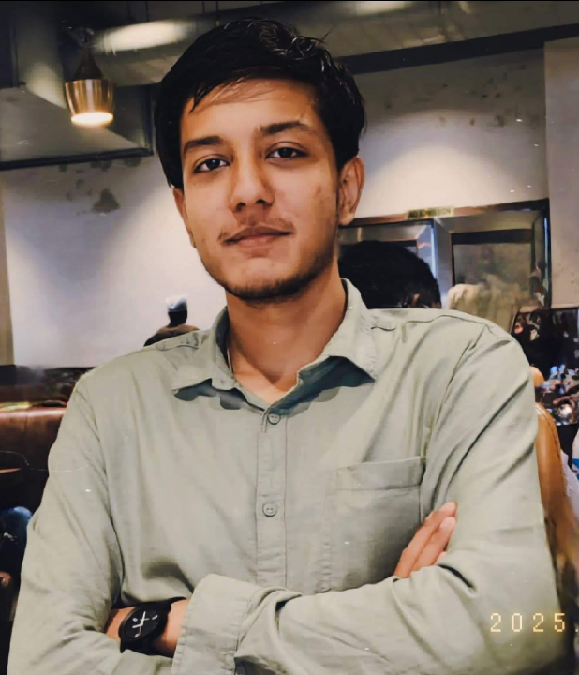
Brief Introduction about me!
Recently, graduated From Acharya Institute of Technology Batch – 2021 to 2025
Experiences
Worked as an Application Developer Intern in Malcom (Nov 2024 – April 2025).
Tech Stack I worked on were – React Native, NodeJS and Python.
Currently working as Data Analyst in VOIS (Vodafone Intelligent Solutions).
Tools I am working on – Power BI, Automation, Python, Power Suites

Slide 4
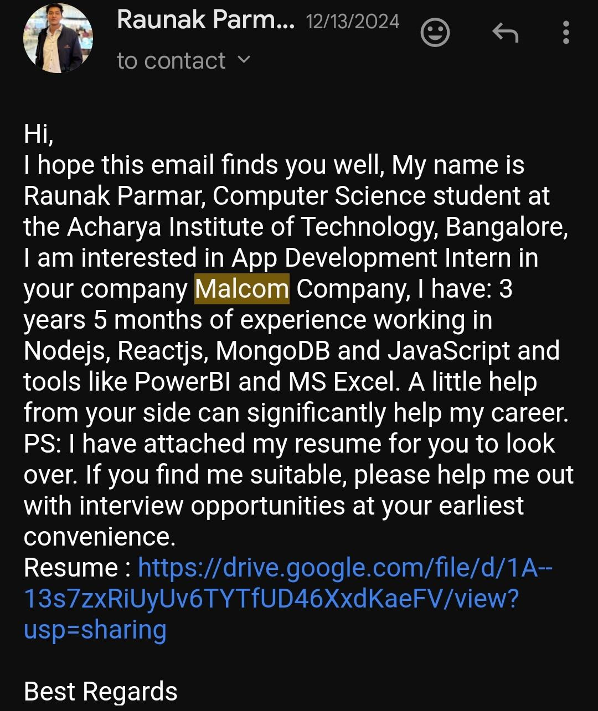
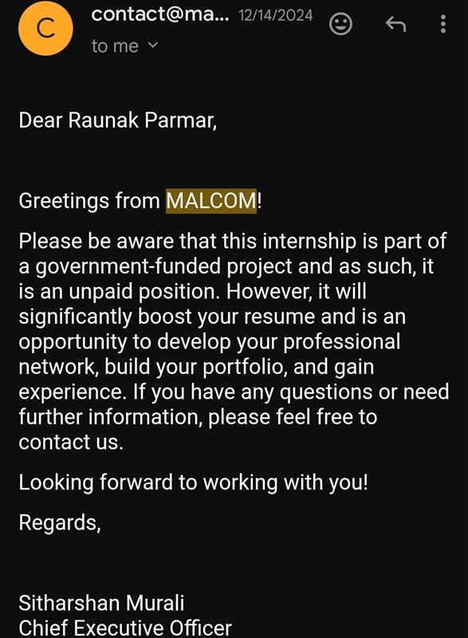
A personal quote or motto that inspires you

Slide 5
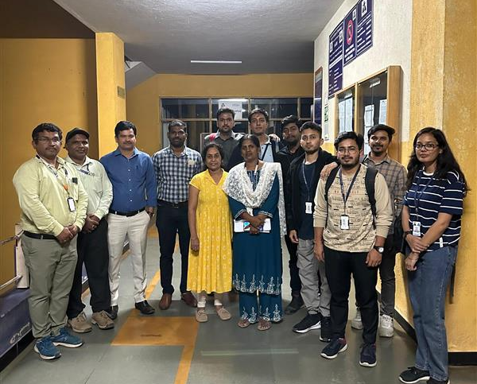
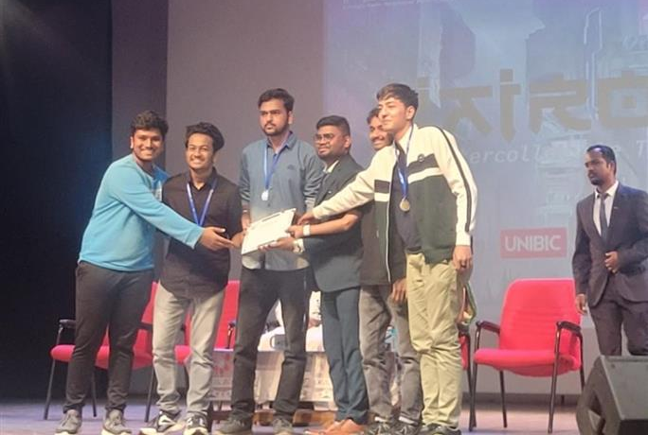
College Support & Faculty Interaction
College Academic Support
Consistent encouragement and resources from faculty helped me maintain focus and motivation during academic and career planning.
Workshops and Career Counseling
Workshops and seminars exposed us to industry trends and helped develop skills necessary for professional success. (CoCubes Training)
Senior Peer Mentorship
Interaction with seniors provided real-world insights, motivation, and practical advice for internships and job preparation.
Professional Growth Ecosystem
The combined college support and senior guidance created a nurturing environment essential for securing internships and jobs.

Slide 6
Top 3 College Learnings
These are my learning, so it is not necessary that it will match with yours as well ☺
1) Networking with Teachers is more important than Seniors - Building relationships with alumni and seniors opens doors to mentorship and job opportunities.
2) Practical Exposure through Projects - Hands-on projects and internships during college give you real-world experience that recruiters value.
3) Time Management & Discipline - Balancing academics, projects, and extracurricular activities teaches you how to prioritize effectively.
6

Slide 7
Motivation and mentorship? Because panic is a great motivator
How to Prepare for Interviews that helped me Aswell -
Research the Company & Role Understand the company’s products, services, and culture. Review the job description carefully to know what skills they value.
Practice Common Questions Prepare answers for behavioral questions (e.g., “Tell me about yourself”) and technical questions relevant to your field.
Know Your Resume Be ready to explain every project or experience you’ve listed. Interviewers often dig deeper into your resume.

Slide 8
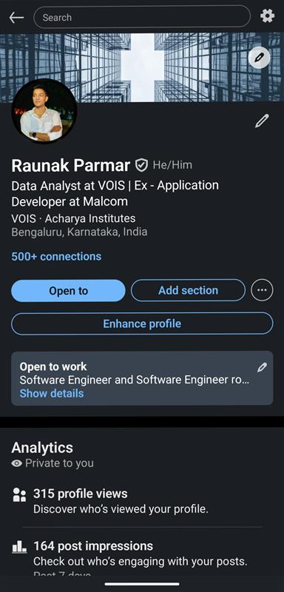
Thank you, guys, for your valuable time and patience
Q&A – Your Questions, My Experience
LinkedIn – Raunak Parmar
Email – raunakparmar1@gmail.com

